Slide 1
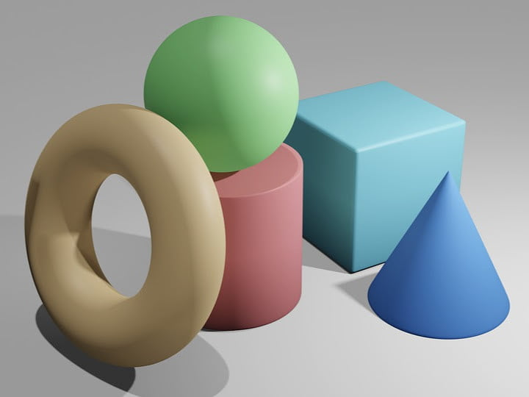
Topic 3: Application Study
Visual Question Answering
Neuro-symbolic AI
Jorrit Willaert

Slide 2
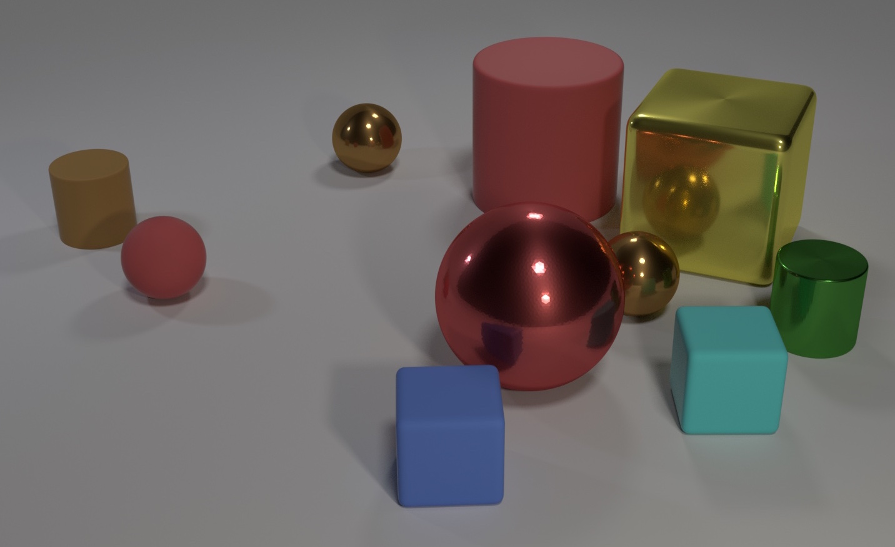
CLEVR dataset
Q: Are there an equal number of large things and metal spheres?
Q: What size is the cylinder that is left of the brown metal thing that is left of the big sphere?

Slide 3

Sort-of-CLEVR dataset
Non-relational questions:
  Shape
  Position
Relational questions:
  Shape of the object closest to the object under investigation
  Color of the object closest to that object
  Number of objects with the same shape
Modification: grid

Slide 4
Initial Idea: Visual Question Anwering
Sort-of-CLEVR dataset with grid modification (5 by 5)
System 1: Twenty five CNN’s
  Object located
  Shape
  Color
System 2: Rule-based mechanisms
  Answer questions

Slide 5
Questions
Feasibility?
Allowed to modify CNN’s?
  Making changes in DeepProbLog or making DeepProbLog program?

Slide 6
Answers
Feasible
Make a neural network in Pytorch, give name and load it via the ‘nn’ in DeepProbLog; You need to make model and the DeepProbLog program
Start with 2 x 2 grid; Use small CNN’s (1 layer, few neurons)
Computational burden will be the logic program
Labels: is the yellow object left of the one under investigation (end-to-end!)
Extra idea if time left:
  Fixed number of objects; 1 CNN for whole image
  Is the first object left of the second?

